Slide 1



Version Control with Git
Mini Project
Gourav Kumar
18MCR004
Kongu Engineering College
Notes:
10 December 2020
1

Slide 2
Objective:
Ram and Sam are friends and they collaborate to complete the solution proposed for ISRO on accurate speed prediction of launch vehicle PSLV. Ram is concentrating on the launch vehicle parameters and Sam is on the forecasting of the speed of the launch vehicle

Slide 3
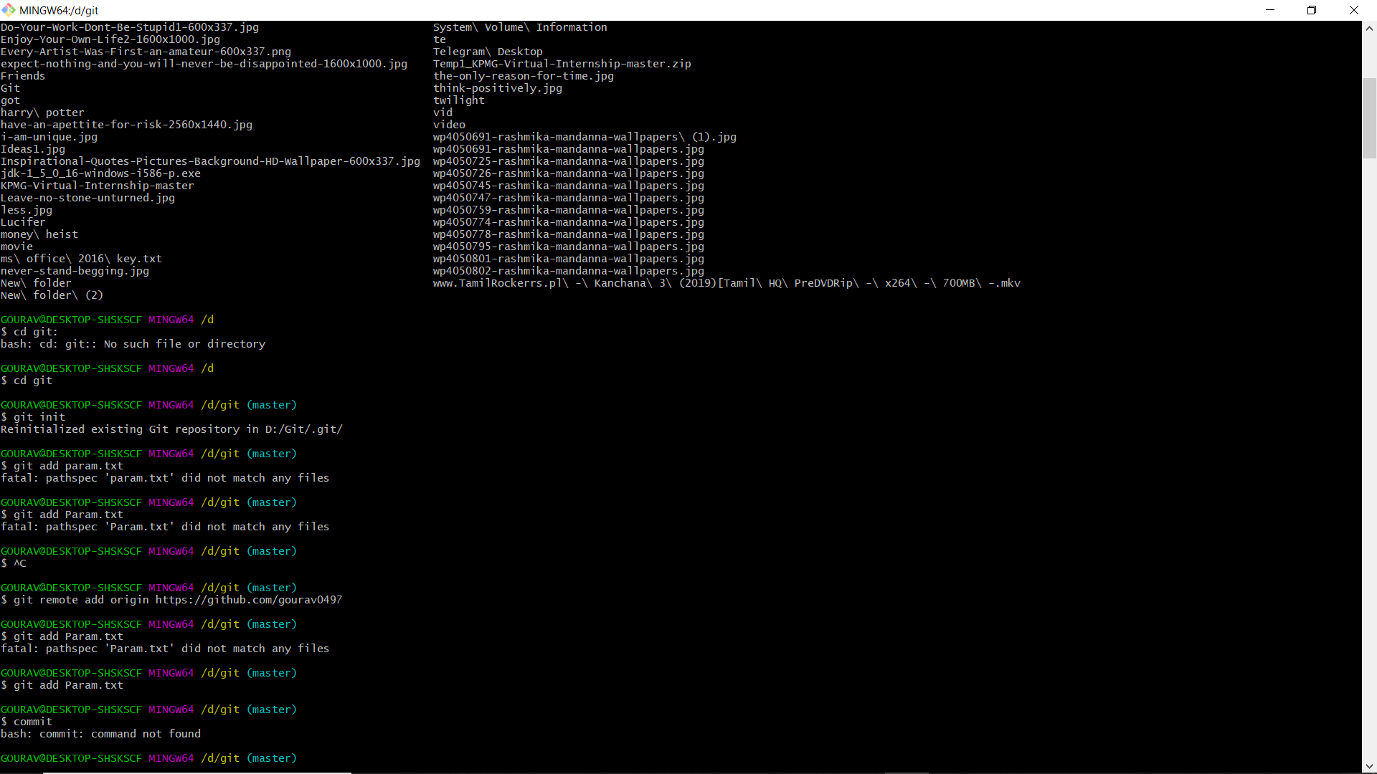
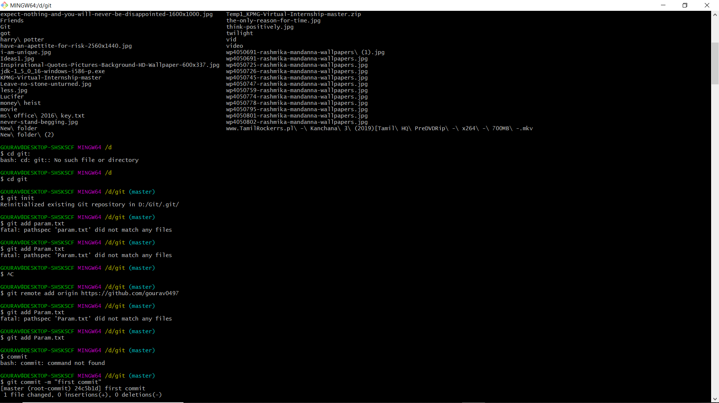
Create a repository VEHICLE with contain Param.txt – Initial empty file
Set origin

Slide 4
Commit 1: Base param – master branch

Slide 5
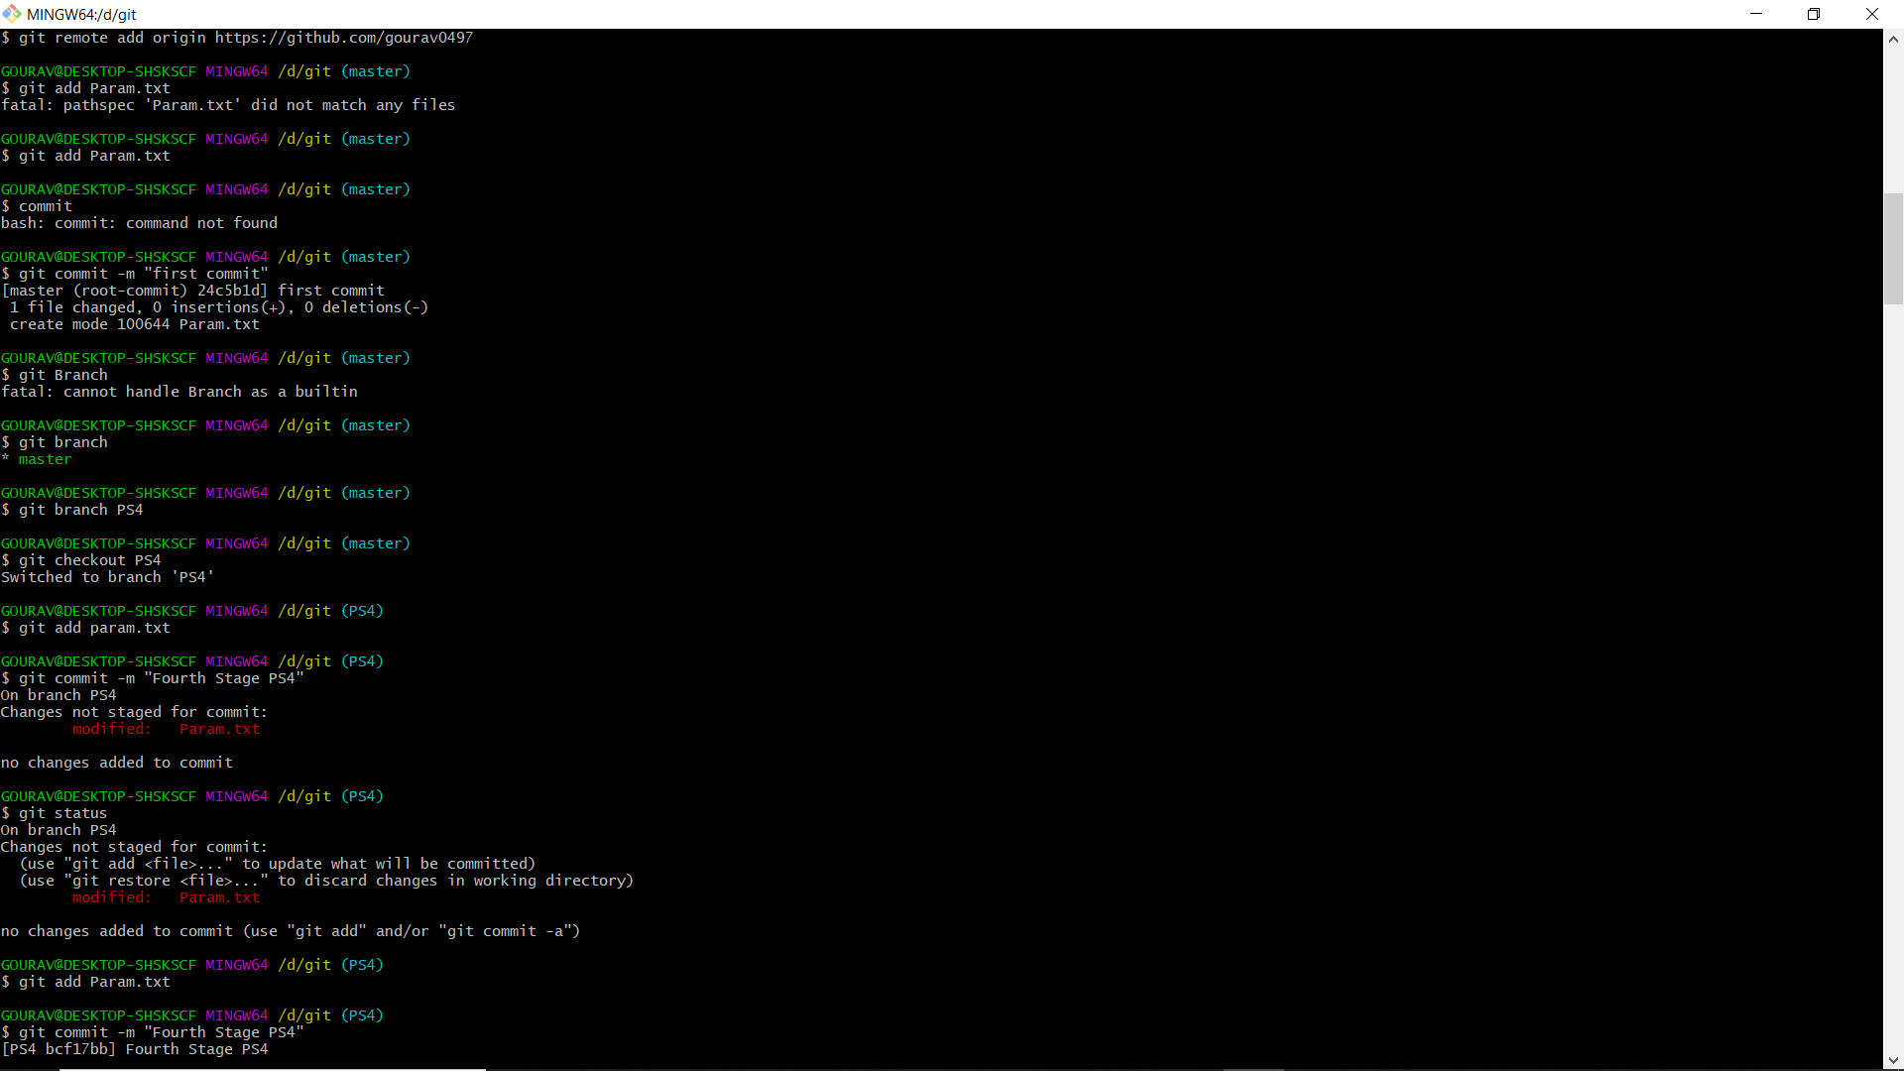
Commit 2: Fourth Stage PS4 – Branch: PS4

Slide 6
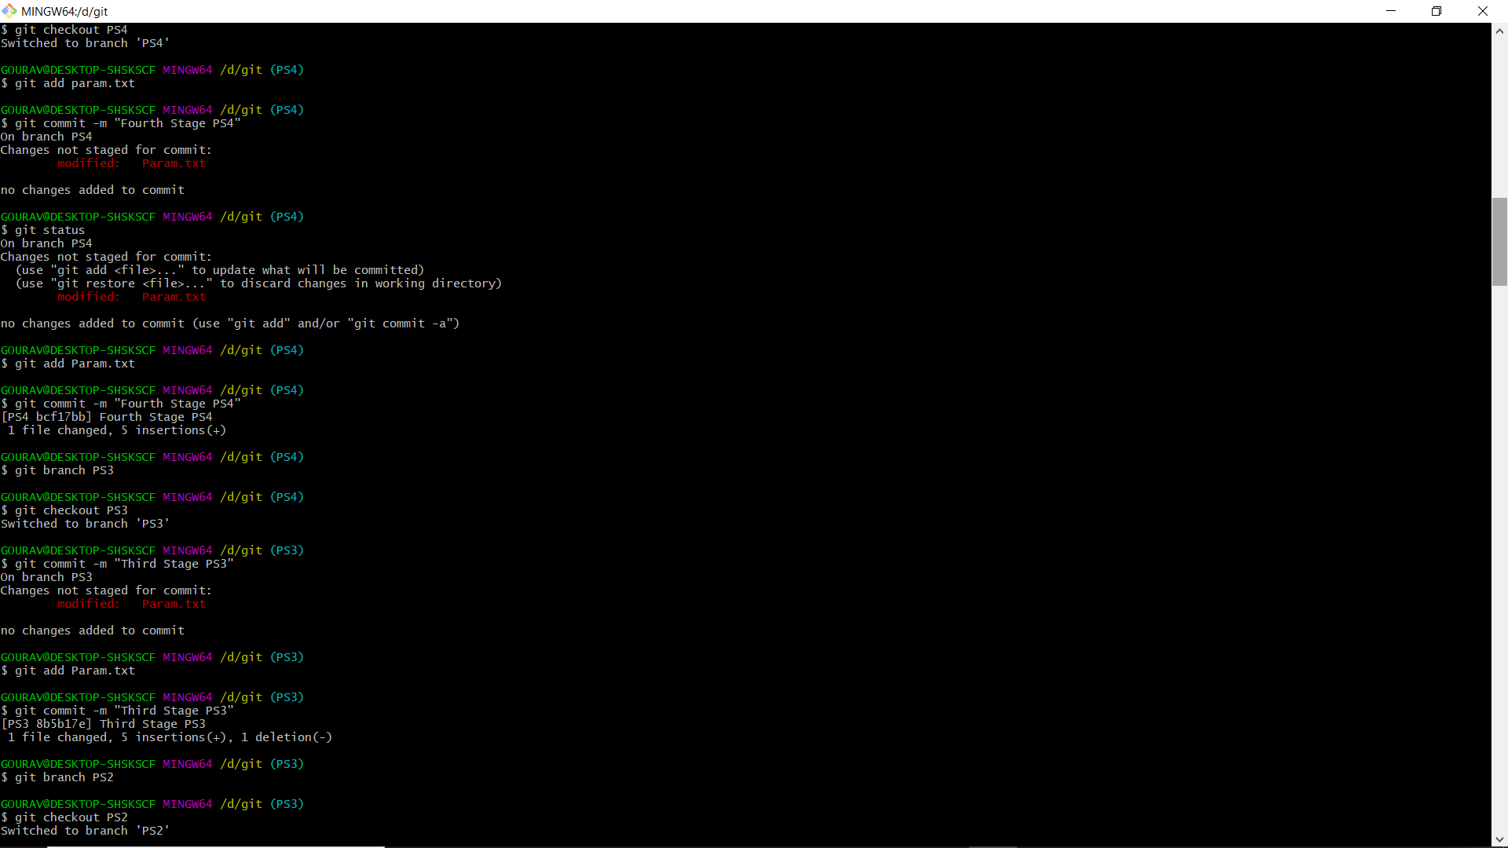
Commit 3: Third Stage PS3 – Branch: PS3

Slide 7
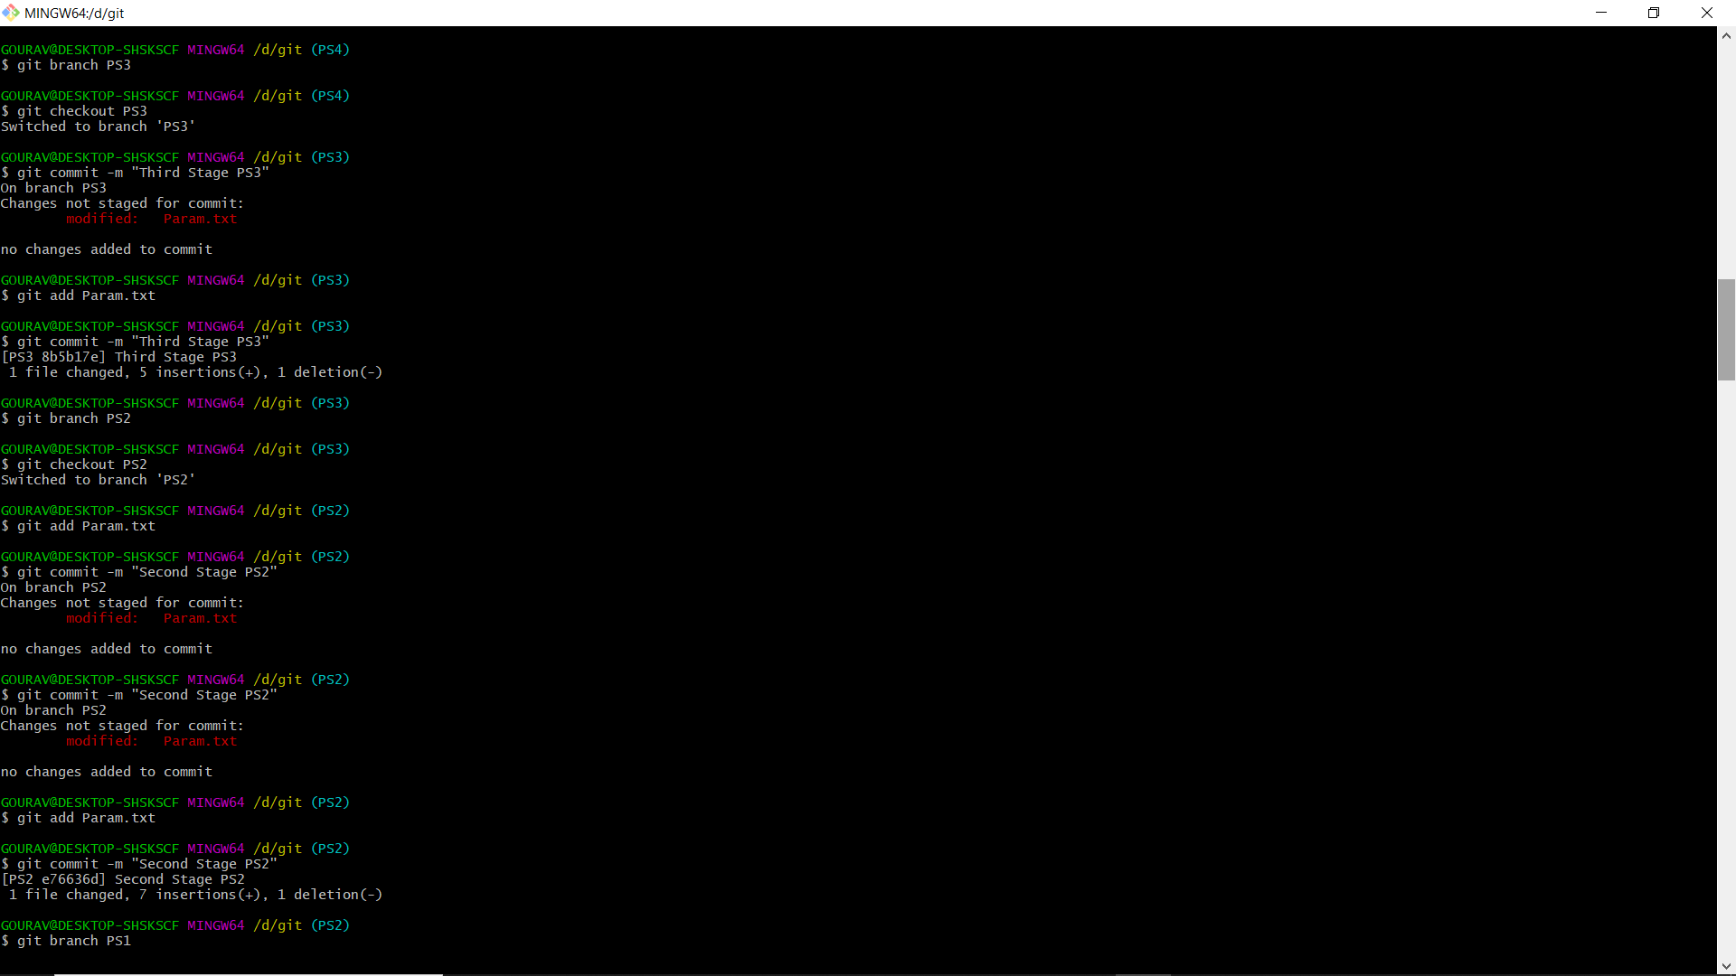
Commit 4: Second Stage PS2 – Branch: PS2

Slide 8
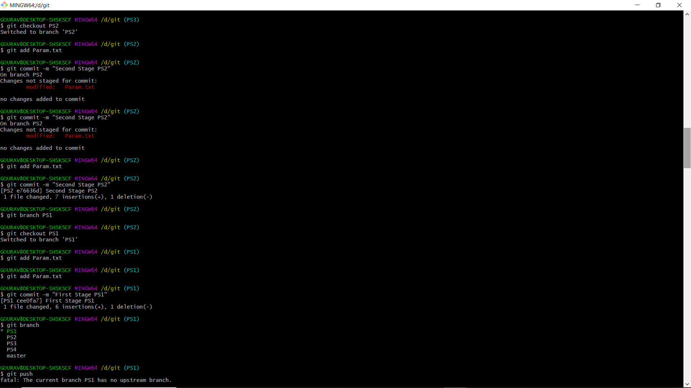
Commit 5: First Stage PS1 – Branch: PS1

Slide 9
Ram committed all the stages of the launch vehicle from fourth to first in sequence in Param.txt and pushed to VEHICLE
Currently the pointer is at PS1

Slide 10
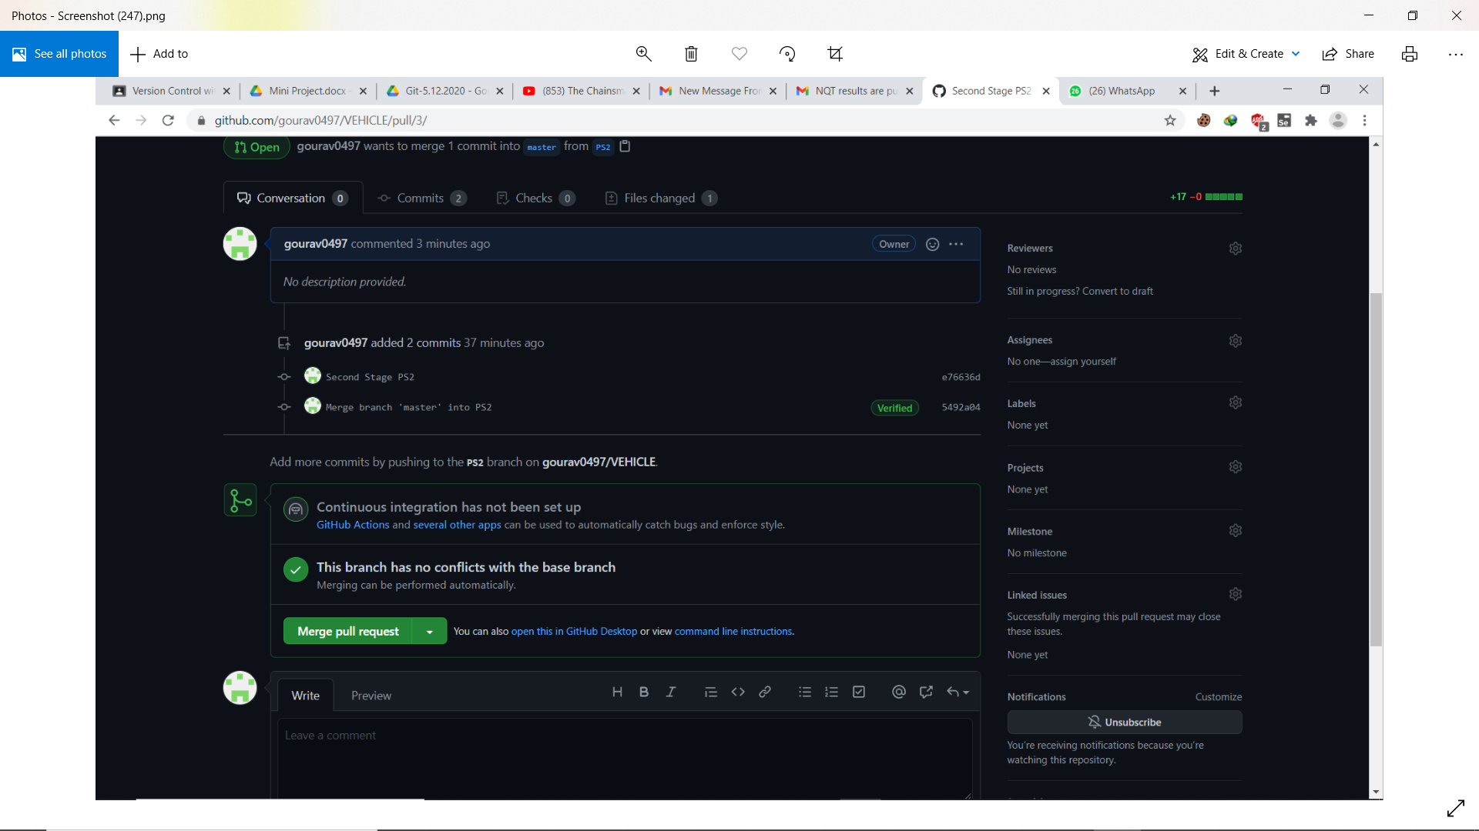

Slide 11
Ram committed all the stages of the launch vehicle from fourth to first in sequence in Param.txt and pushed to VEHICLE
Currently the pointer is at PS1

Slide 12
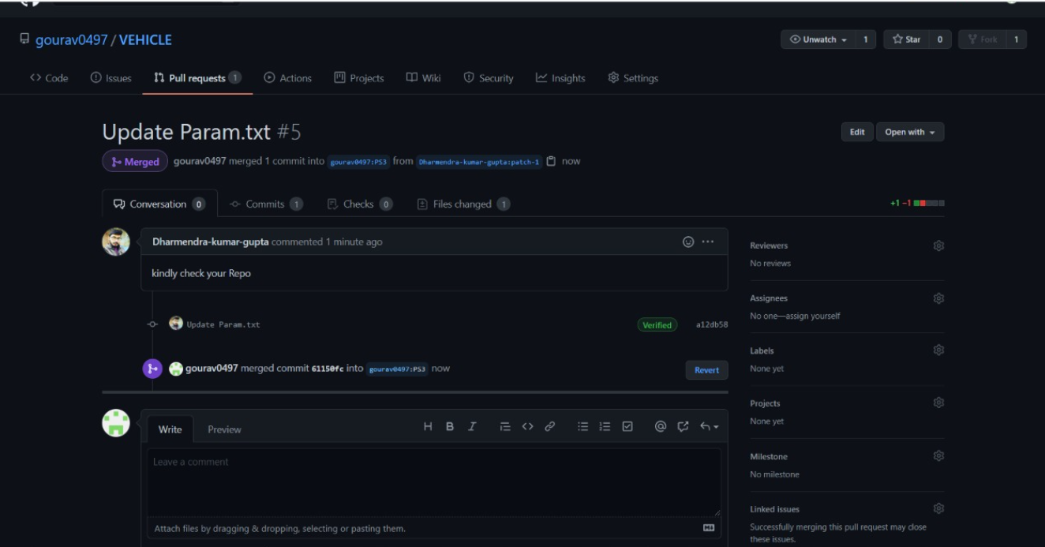
Now Sam looks into parameter file of the vehicle and proposed forecasted speed of the vehicle. Sam’s repository is SPEED with file Param.txt (launch vehicle parameters) and vehicle_speed.txt

Slide 13
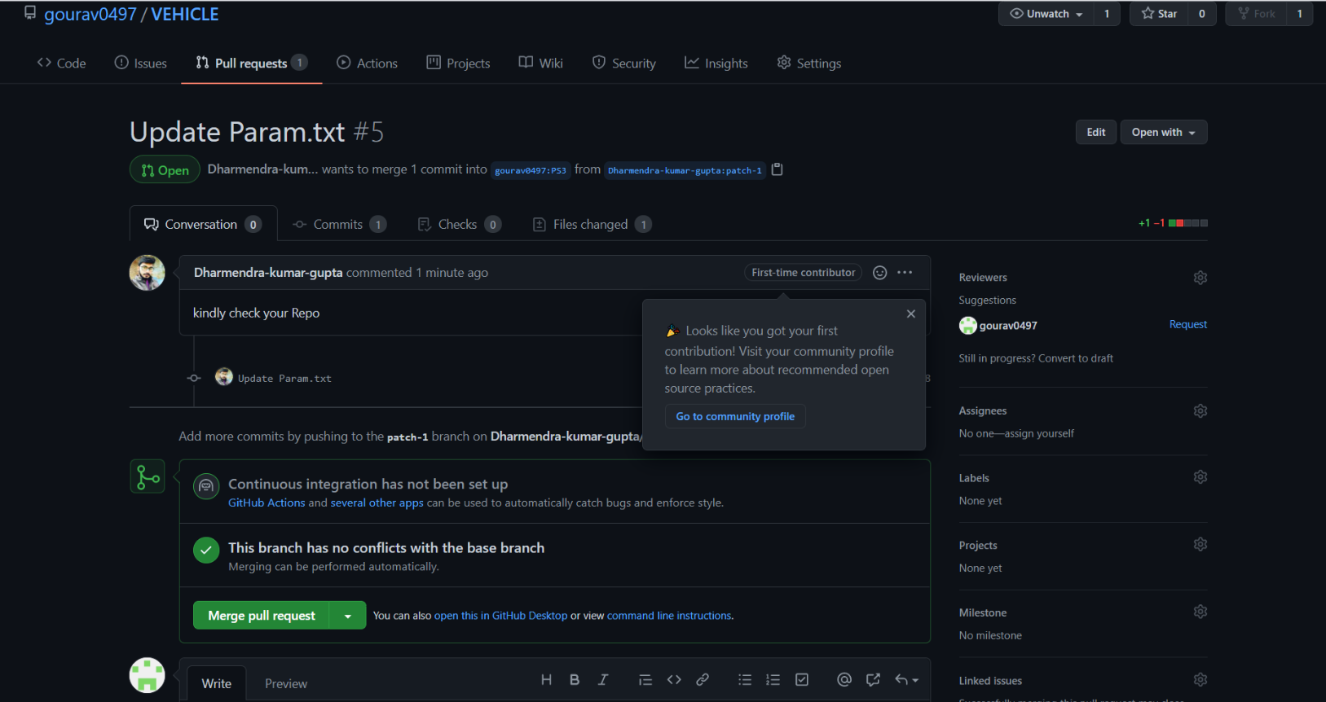
For speed prediction, Sam noticed the Max. Thrust in PS3 stage has to modified for proper working of launch vehicle. Max. Thrust: 252 kN and made a pull request to Ram and changes are updated

Slide 14
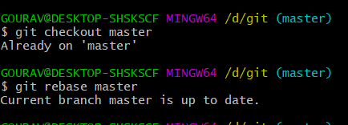
Speed parameter is also included in Param.txt by Sam. Updation of speed is the latest commit, which head should

Slide 15
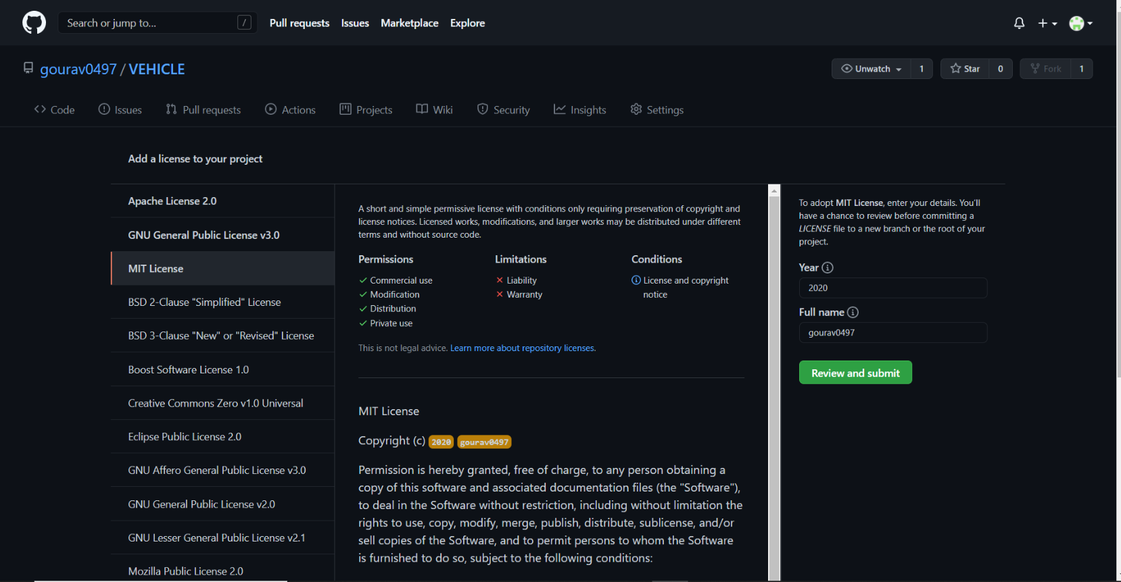
Include MIT License

Slide 16
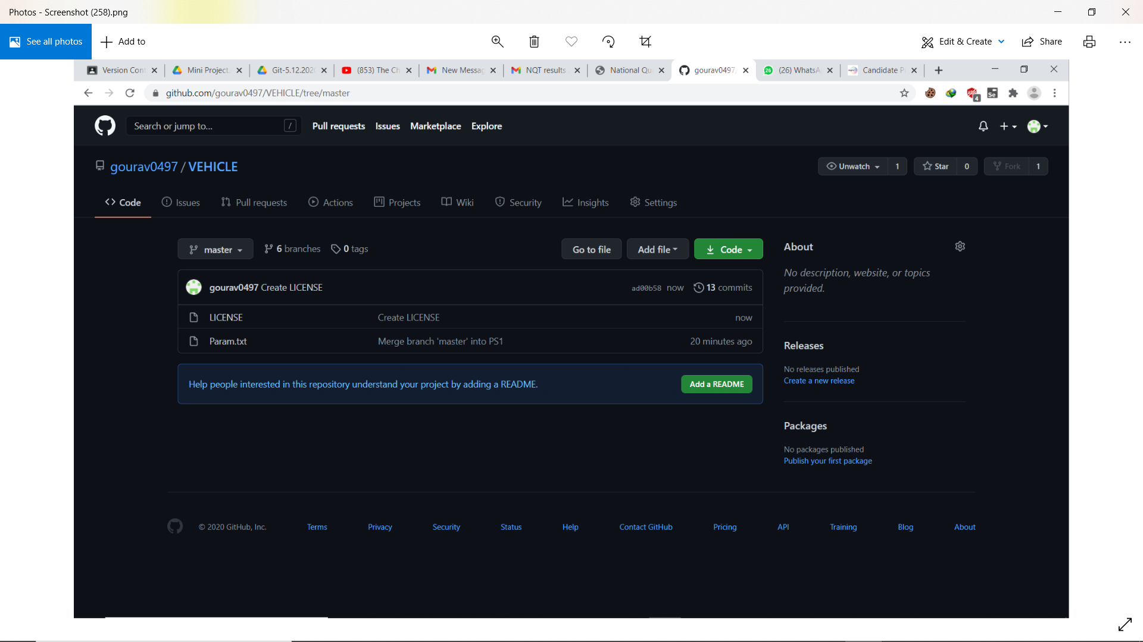

Slide 17
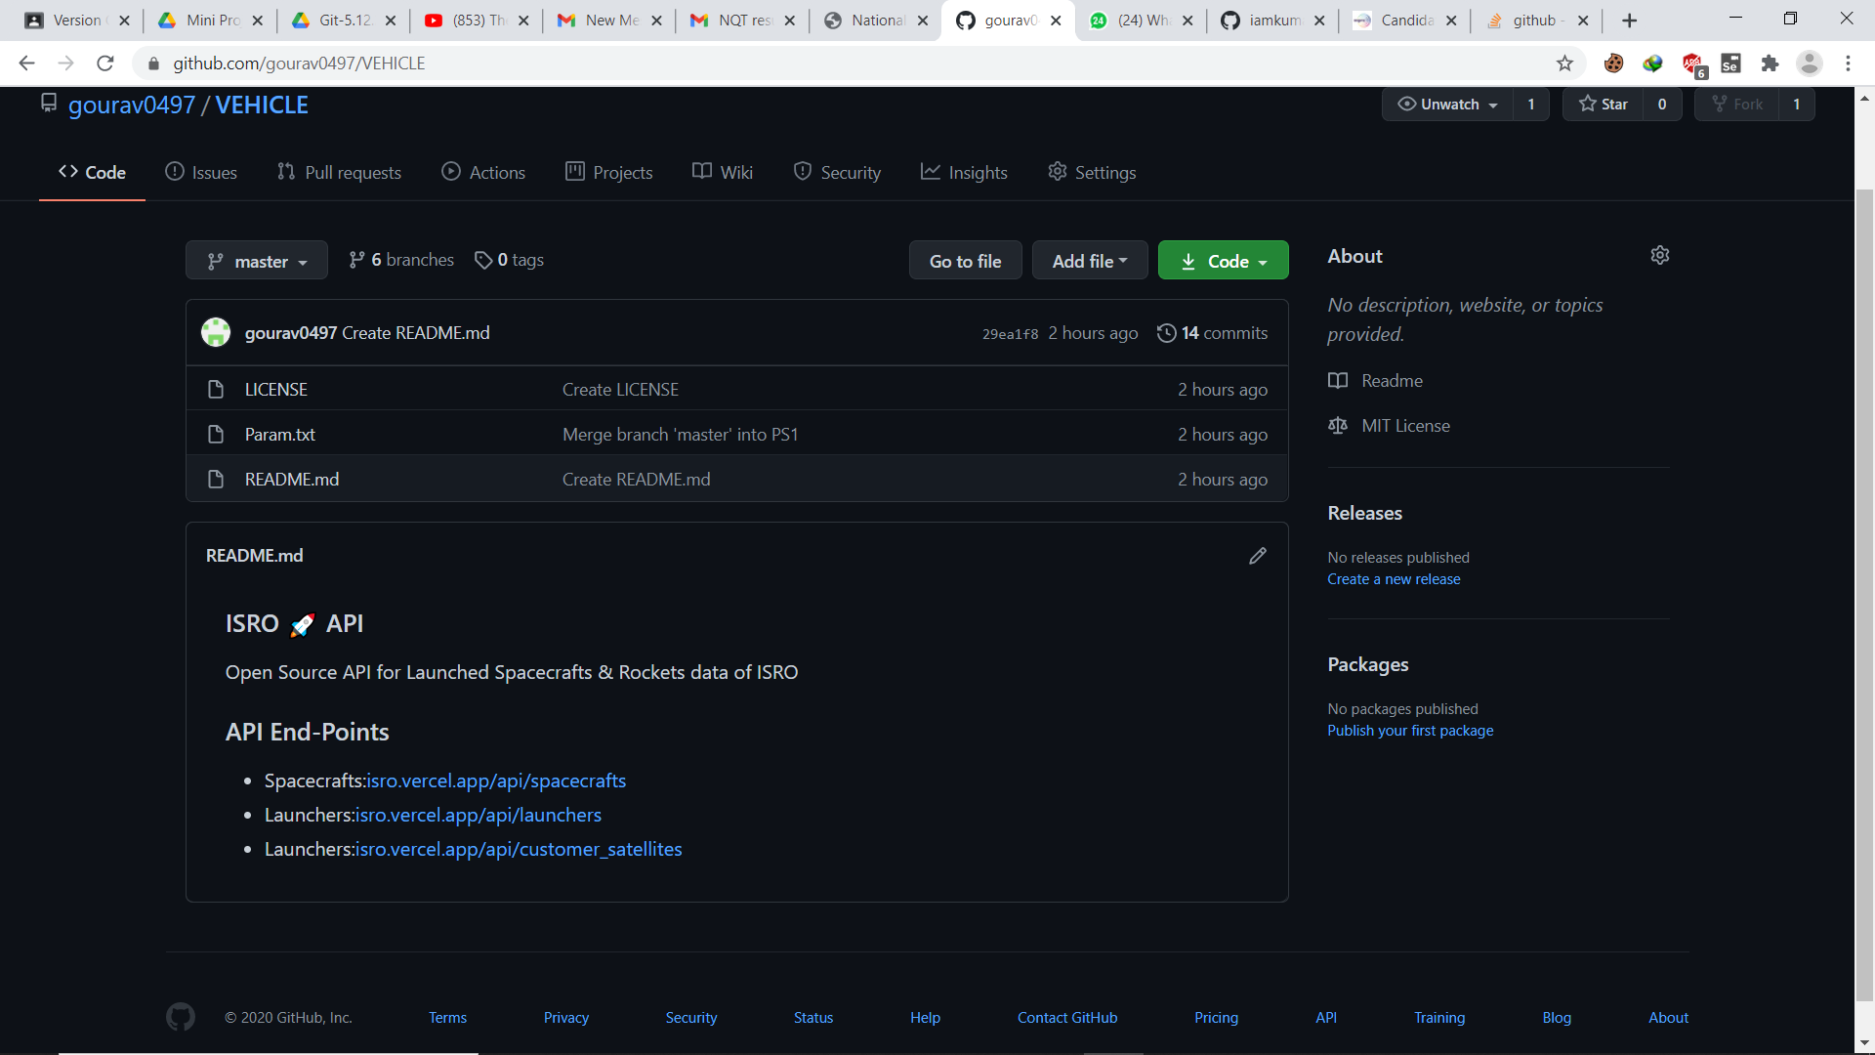
Create README file

Slide 18


